Slide 1
Green Advertising on Social Media: Brand Authenticity Mediates the Effect of Different Appeals on Purchase Intent and Digital Engagement
Matthew Pittman¹, Anne Oeldorf-Hirsch², & Ashley Brannan²

Slide 2
Social Norms in Green Advertising
Social Norms Theory (Perkins and Berkowitz (1986):
dictates that when making certain decisions an individual will first determine the acceptable behaviors or beliefs of a social group (perceived norms) and then conform to those perceived norms.
Social media platforms unique due to their greater interactivity, engagement, and social visibility
High observability and presence of others makes social norms salient
Brand quality and authenticity may be key in explaining effects of persuasion attempt on purchase intention

Slide 3
Theorized Model
H1: On news media, brand quality will mediate the effect of appeal type on purchase intention (Study 1) and digital engagement (Study 2).
H2: On social media, brand authenticity will mediate the effect of appeal type on purchase intention (Study 1) and digital engagement (Study 2).
Ad appeal
Brand quality
Purchase intention
Brand authenticity
Digital engagement
Ad platform

Slide 4
Methods & Participants
Design: 2 (platform: news website vs. social media) X 3 (appeal: product vs. environmental vs. hybrid) between-participants design
Study participants: MTurk, paid $.51
Study 1: N = 392
M_{age} = 34.5, 50.6% male
Study 2: N = 335
M_{age} = 36.3, 52.2% male
Measures: 7-point Likert scales
Purchase Intent, 2 items (r = .75), Spears & Singh, 2004: “I would like to buy this product in the future,” and “I would be willing to pay a little more for this product”
Environmental Attitude (M = 5.69, SD = 1.17): “I care a lot about the environment”
Brand Quality (M = 5.32, SD = 1.35): “_____ seems like a brand that makes a quality product”
Brand Authenticity (M = 5.42, SD = 1.51): “_____ seems like a brand that really cares about the environment”

Slide 5
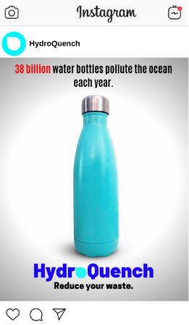
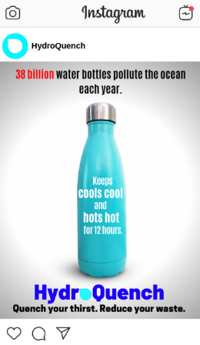
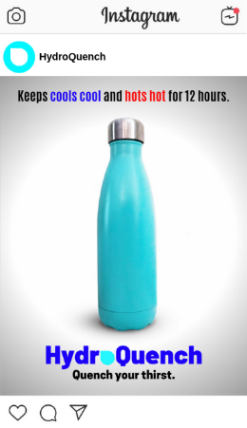
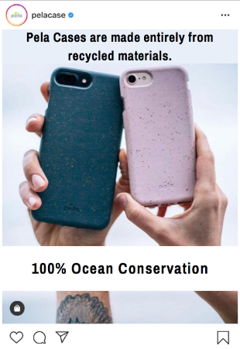
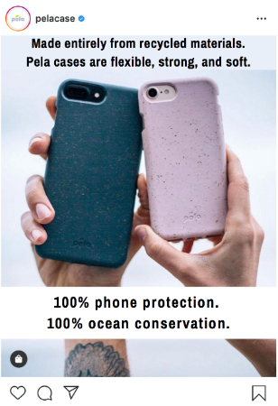
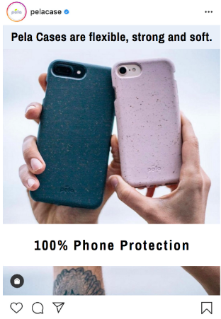
Stimuli
Study 1 Water bottle, Instagram (vs traditional media)
Study 2 Phone case, Facebook (vs traditional media)

Slide 6
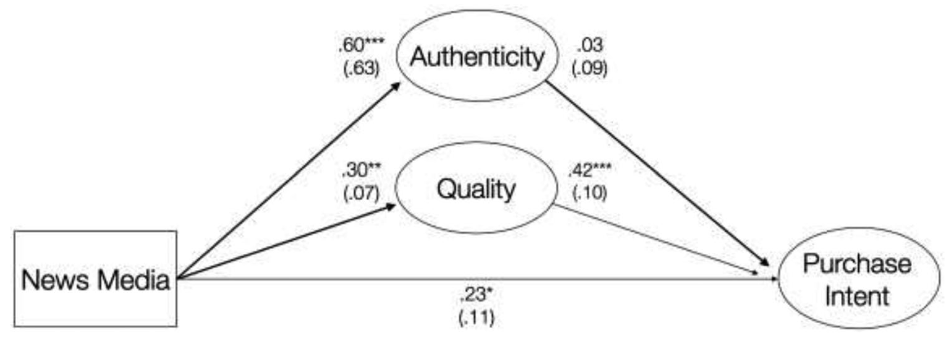
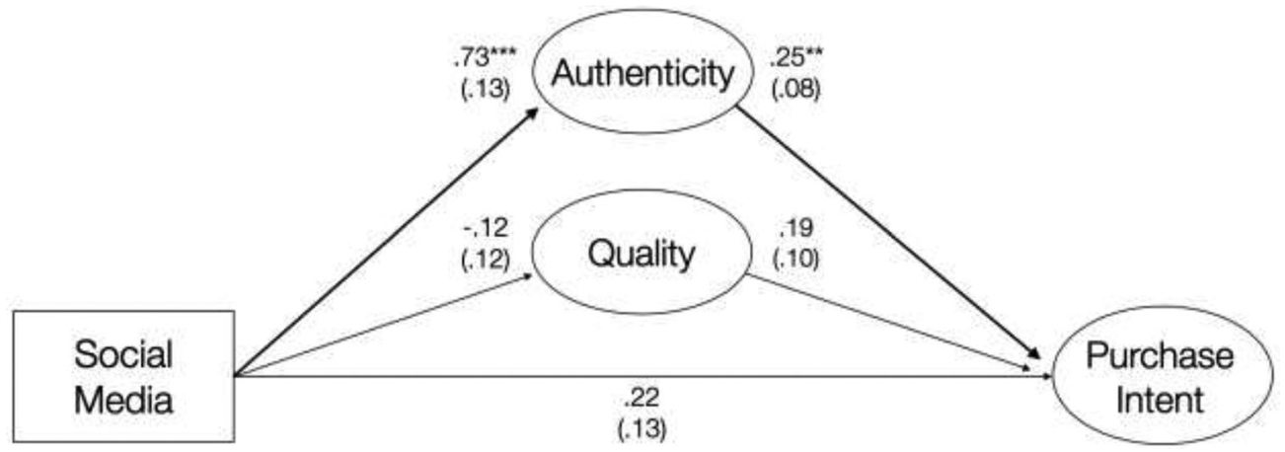
Study 1 results : Social Media, Purchase Intent

Slide 7
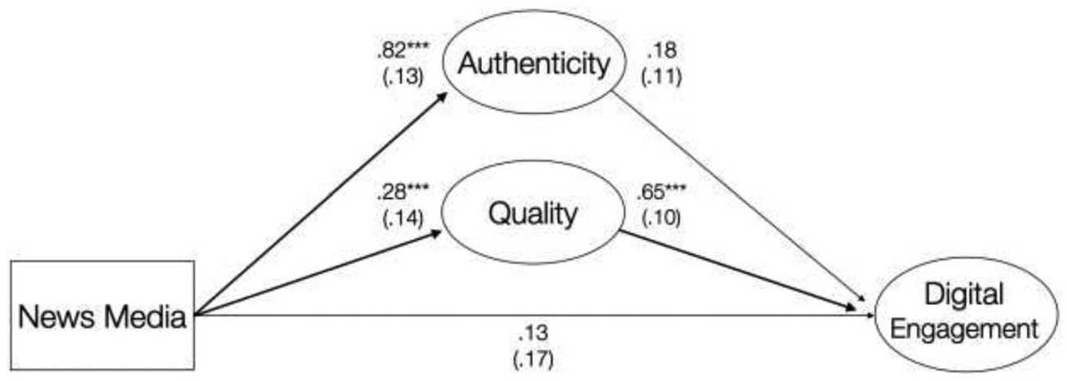
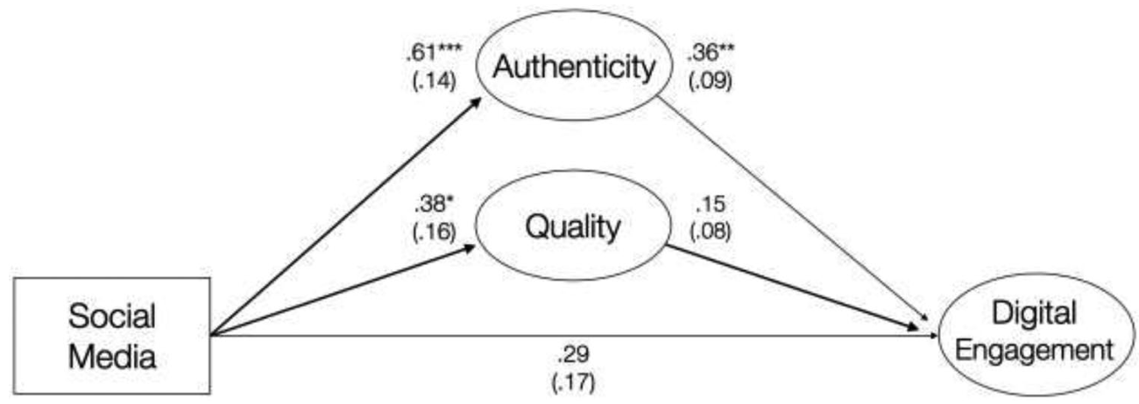
Study 2 results: Social Media, Digital Engagement

Slide 8
Key Takeaways
What is more important for a green brand: Quality or authenticity? It depends:
Advertisements appealing to both product and environmental concerns most effective at attracting consumers across platforms
On news (non-social) website: Consumers value products that benefit themselves
On social: Consumers likely to engage with green product if brand appears to genuinely care about sustainability. Promoting product benefits here can make PI actually go down.
Next steps?
Making green vs going green?
Green tips

